Slide 1
Observation
Have you ever:
Asked a friend what was appropriate to wear to a dinner, party, or wedding?
Agreed to buy something you didn’t want?
Agreed to attend a social event because someone else asked you to?
Changed your behavior in response to a direct order from a parent, teacher, or school/ institute official?

Slide 2
Discussion Question
You read a report about health drinks and health.
Would you react differently to the message if the report was written by a Nobel prize winning bio-medical scientist than you would if it was written by a acclaimed food critic?
If so, why?
If not, why not?

Slide 3
The Communication-Persuasion Paradigm
Source |  | Message |  |  | Target |  | Effect
expertise |  | discrepancy |  |  | intelligence |  | change attitude
trustworthiness |  | fear appeal |  |  | involvement |  | reject message
attractiveness |  | 1-sided or 2-sided |  |  | forewarned |  | Counter-argue
 |  |  |  |  |  |  | suspend judgment
 |  |  |  |  |  |  | derogate source
Notes:
Figure 7.1

Slide 4
Social Influence
Efforts by one or more individuals to change the attitudes, beliefs, perceptions, or behaviors of one or more others
Notes:
10
10
4

Slide 5
Social Influence
Social influence occurs when:
one person (the source) engages in some behavior (persuading, threatening, promising, or issuing orders)
that causes another person (the target) to behave differently from how he or she would otherwise behave.

Slide 6
Influence attempts can be either open or covertly manipulative.
In open influence, the attempt is readily apparent to the target.
In manipulative influence, the attempt is hidden from the target.
Goals of Social Influence
Choosing Correctly
Gaining Social Approval
Being Consistent with Commitments

Slide 7
Conformity
Conformity—a type of social influence in which individuals change their attitudes or behavior in order to adhere to social norms:
Rules regarding how people are expected to behave in specific situations
Notes:
10
10
4

Slide 8
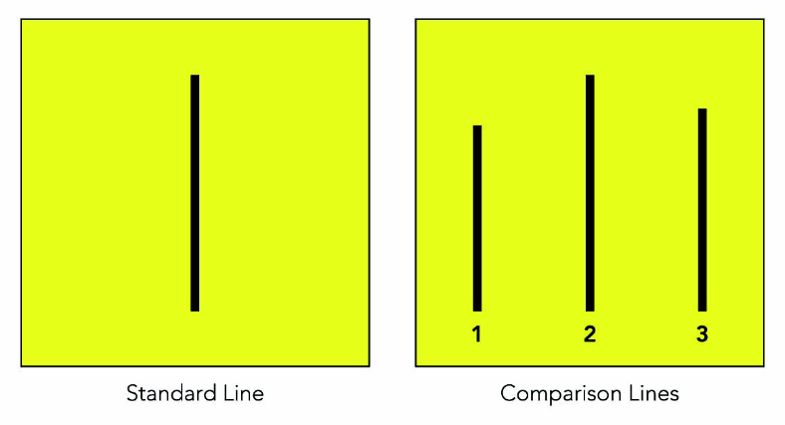
Conformity
Asch’s (1950s) Research on Conformity
Participants were asked to indicate which of three lines matched a standard line in length.
Notes:
10
10
4

Slide 9
Conformity
During the critical trials, participants had to give their answers after a unanimous group gave the wrong answer.
76% conformed at least once to the group’s false judgment
Overall, they agreed with the errors 37% of the time
Later research found that an ally (someone who disagreed with the group) and the ability to make responses privately both reduced conformity.
Notes:
10
10
4

Slide 10
Factors that Affect Conformity
Cohesiveness—the degree of attraction felt by an individual toward an influencing group
As cohesiveness increases, conformity increases
Group size
As group size increases, conformity increases to an extent
Descriptive Norms (what most people do in a given situation) and Injunctive Norms (specify what ought to be done)
Notes:
10
10
4

Slide 11
Why People Conform
Normative Social Influence—based on the desire to be liked or accepted by others
Informational Social Influence—based on the desire to possess accurate social perceptions
This is an especially strong source of conformity when the task is important and difficulty and uncertainty are high.
Notes:
10
10
4

Slide 12
Why People Do Not Conform
Individuation—people’s need to be distinguishable from others in some respects
People’s need to maintain control over their lives
Some people cannot conform
Due to physical, legal, or psychological reasons
Notes:
10
10
4

Slide 13
Minority Influence
Minorities can influence majorities when:
They are consistent, flexible, and congruent with social trends
Minorities can provoke majorities to engage in systematic processing of the issues.
Minorities often must form strong arguments to defend their positions and may overestimate the support for their views.
Can increase their perseverance and result in large-scale social change
Notes:
10
10
4

Slide 14
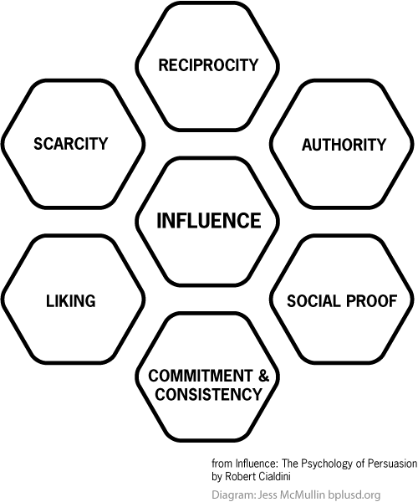
Compliance
Six Principles of Compliance: (Cialdini,1990s)

Slide 15
Compliance
Tactics based on friendship or liking
Ingratiation—requesters first induce target to like them
Use flattery, improve one’s appearance, emit positive nonverbal cues, do small favors for target person
Tactics based on commitment or consistency
Foot-in-the-door Technique—requesters begin with a small request and then, when it is granted, escalate to a larger one
Lowball Procedure—an offer or deal is changed to make it less attractive to the target person after this person has accepted it
Notes:
11
10
4

Slide 16
Compliance
Tactics based on reciprocity
Door-in-the-face Technique—requesters begin with a large request and then, when this is refused, retreat to a smaller one
That’s Not All Technique—requesters offer additional benefits to target persons before they have decided whether to comply with or reject specific requests
Tactics based on scarcity
Playing Hard to Get—suggesting that a person or object is scarce and hard to obtain
Deadline Technique—target persons are told that they have only limited time to take advantage of some offer or to obtain some item
Notes:
11
10
4

Slide 17
Obedience to Authority
Obedience—form of social influence in which one person simply orders one or more others to perform some action(s)
Obedience in the laboratory: Milgram’s Obedience Studies (1963, 1965a, 1974)
Participants told to deliver increasing levels of shock to a “learner” each time he made an error on a learning task
65% obeyed to the fullest extent (proceeded to the end of the series, to the final 450-volt level)
Similar findings were found in many cultures and with adults and children.
Notes:
12
11
4

